Slide 1

Netflix Movies Dataset: Analysis and Insights
Presented by:
Vijay Rangaswamy

Slide 2

About The Dataset

Slide 3

Why Analyze The Dataset?
Explore
Explore Trends: Understand Netflix’s content strategy through release patterns and content diversity.
Analyze
Analyze Preferences: Identify audience preferences by examining ratings, genres, and actor collaborations.
Provide
Decision-Making: Provide actionable insights for better media planning and audience engagement.

Slide 4

Dataset Overview
Key Features:
Includes attributes like type, title, cast, release_year, duration, and more.
Contains information on Netflix Movies and TV Shows, including:
Type: Movie or TV Show
Title: Name of the content
Cast: Key actors and actresses
Release Year: Year the content was added
Duration: Time length (in minutes or episodes)
4307 null values were present in the dataset.

Slide 5

Working On The Dataset

Slide 6
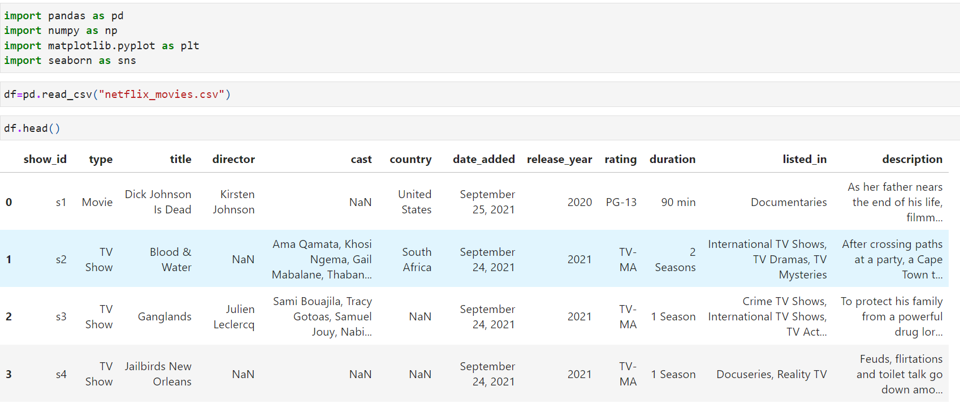
Importing Dataset and Libraries

Slide 7

Data Cleaning
Removed Duplicates: Ensured data accuracy by eliminating duplicate rows.
Handled Missing Values: Replaced NaN entries with "Unknown" to maintain consistency.
Standardized Formats: Unified date formats for easy analysis.
New Columns Added:
loading_year: Extracted from release dates to track yearly trends.
loading_month: Categorized for analyzing seasonal patterns.

Slide 8
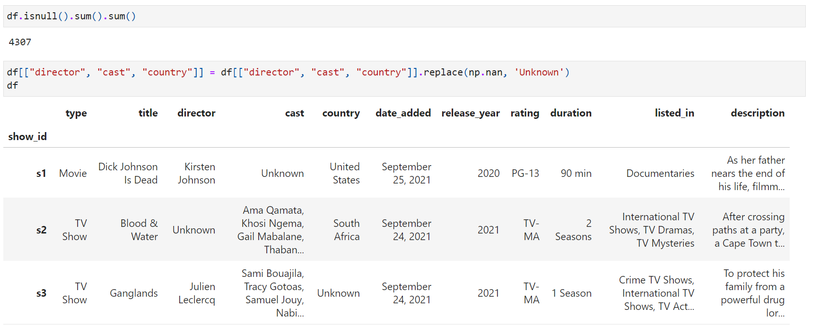
Code And Output

Slide 9

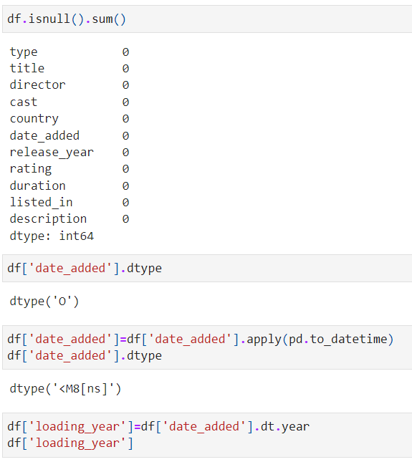
Codes to clean data

Slide 10

Questions

Slide 11
Show all the Movies & TV Shows released by month

Slide 12
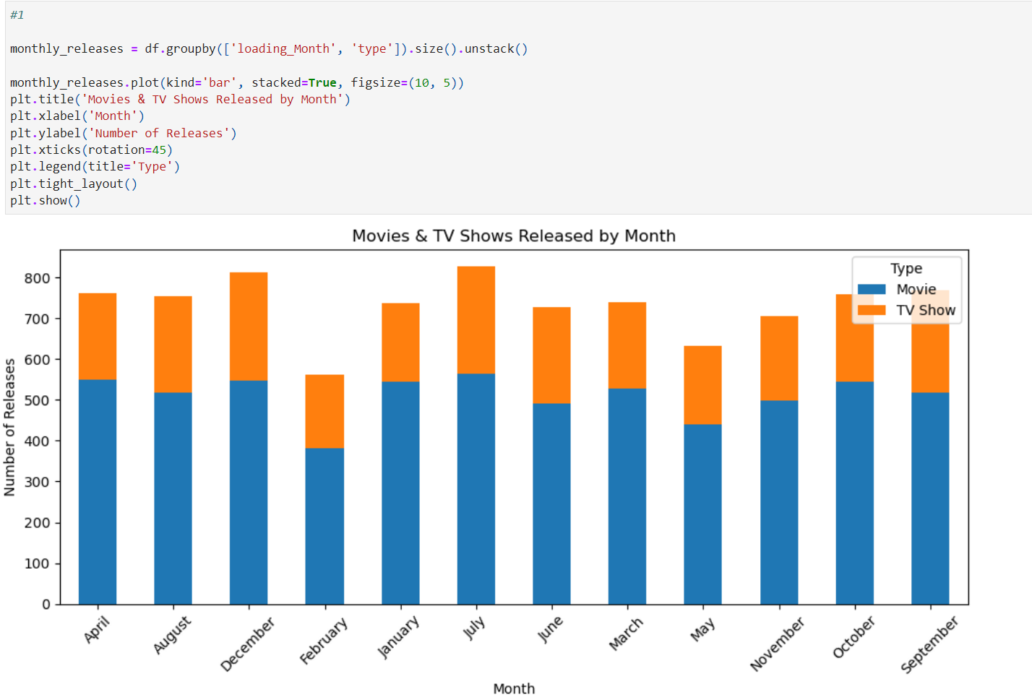
Movies & TV Shows Released by Month

Slide 13
Insights
Peak Activity: Most releases occur in December and July.
Seasonal Patterns: February and May show reduced activity.
Movies vs. TV Shows: Movies consistently outpace TV shows in monthly releases

Slide 14
Count all the types of unique rating & which rating are with most number

Slide 15
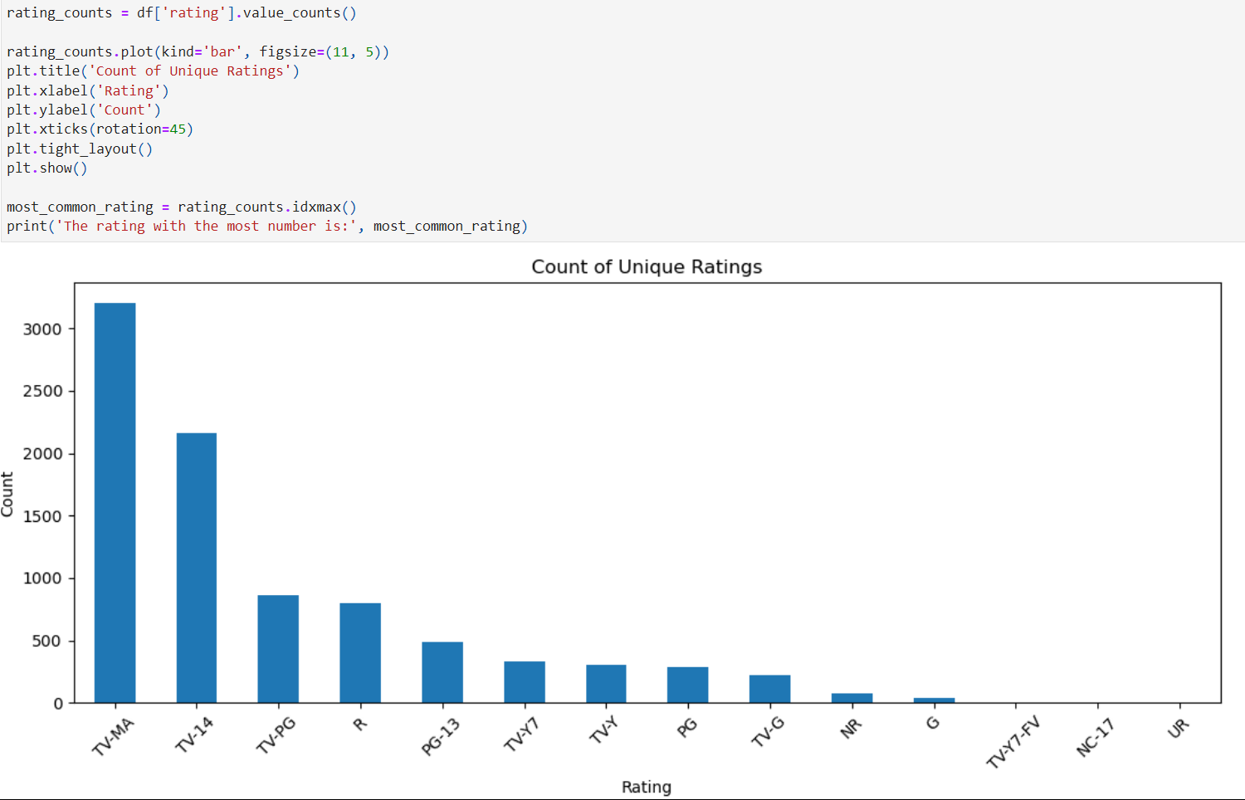
Bar chart for unique ratings.

Slide 16

Insights
Most Common Rating: "TV-MA" (Mature Audience) is dominant.
Focus on Diversity: A wide range of ratings indicates varied audience targeting.
Mature content strongly aligns with Netflix’s primary demographic.

Slide 17
All movies of Salman, Shah Rukh and Akshay Kumar

Slide 18

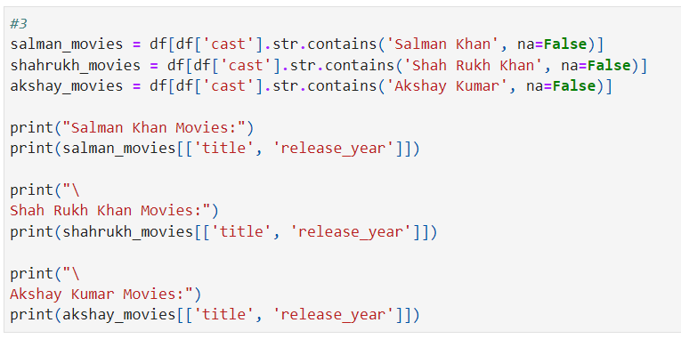
Movies per actor.

Slide 19
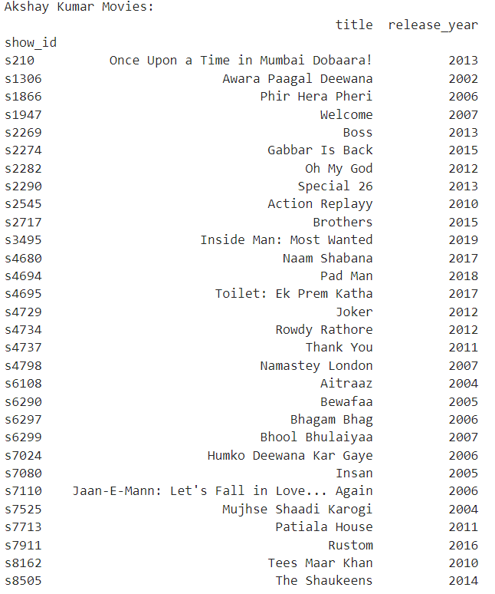

Movies per actor.

Slide 20

Insights
Akshay Kumar leads with the most movies.
Shah Rukh Khan and Kajol: Iconic collaborations include Kuch Kuch Hota Hai and Kabhi Khushi Kabhie Gham.
Salman Khan: Limited but impactful appearances.

Slide 21
Find out the Movies & Series that have Maximum time length

Slide 22
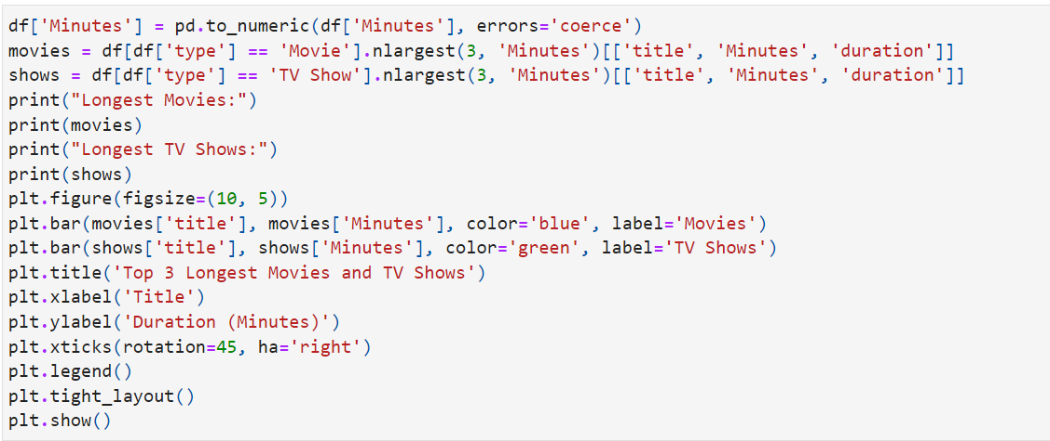
Content with Maximum Duration(Code)

Slide 23
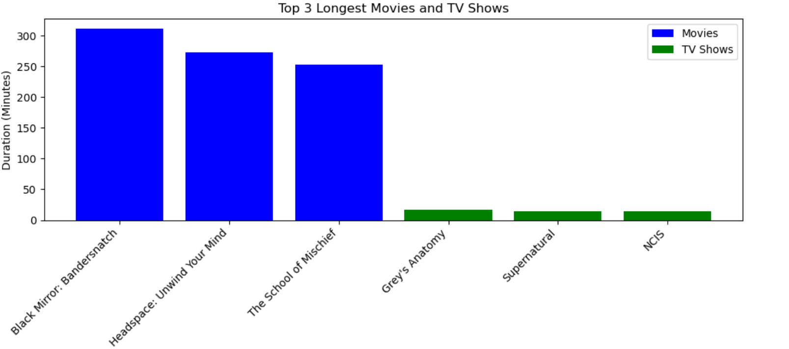
Graph

Slide 24

Insights
Movies tend to have significantly longer durations than TV shows.
Highlight unusual content exceeding standard runtime, such as documentaries or feature films.
Black mirror: Bandersnatch has the longest duration in movies.
Grey's Anatomy has the longest duration in TV Shows.

Slide 25
Year on Year shows added on Netflix by its type

Slide 26
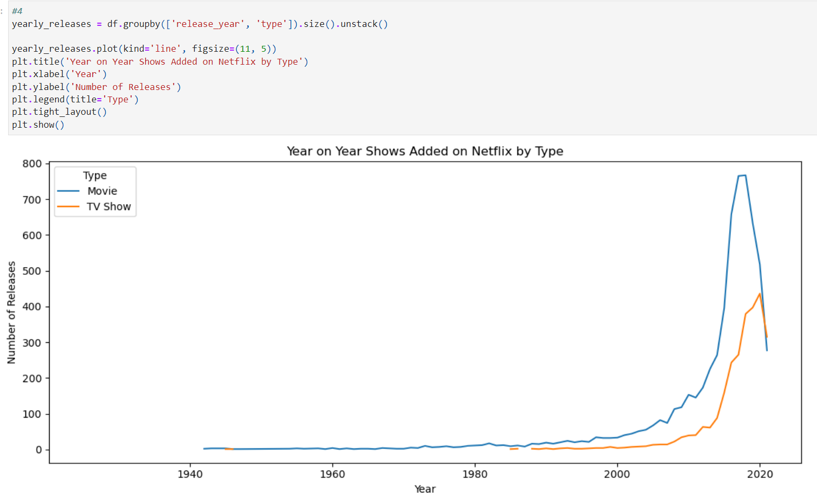
Year-on-Year Additions on Netflix

Slide 27

Insights
2010
Gradual Rise: Steady growth in content additions after 2010.
2020
Post-2020 Decline: A significant drop, possibly influenced by global events (e.g., COVID-19).

Slide 28
Which are Akshay Kumar's comedy movies, Shah Rukh Khan-Kajol films, and Salman-Akshay collaborations?

Slide 29
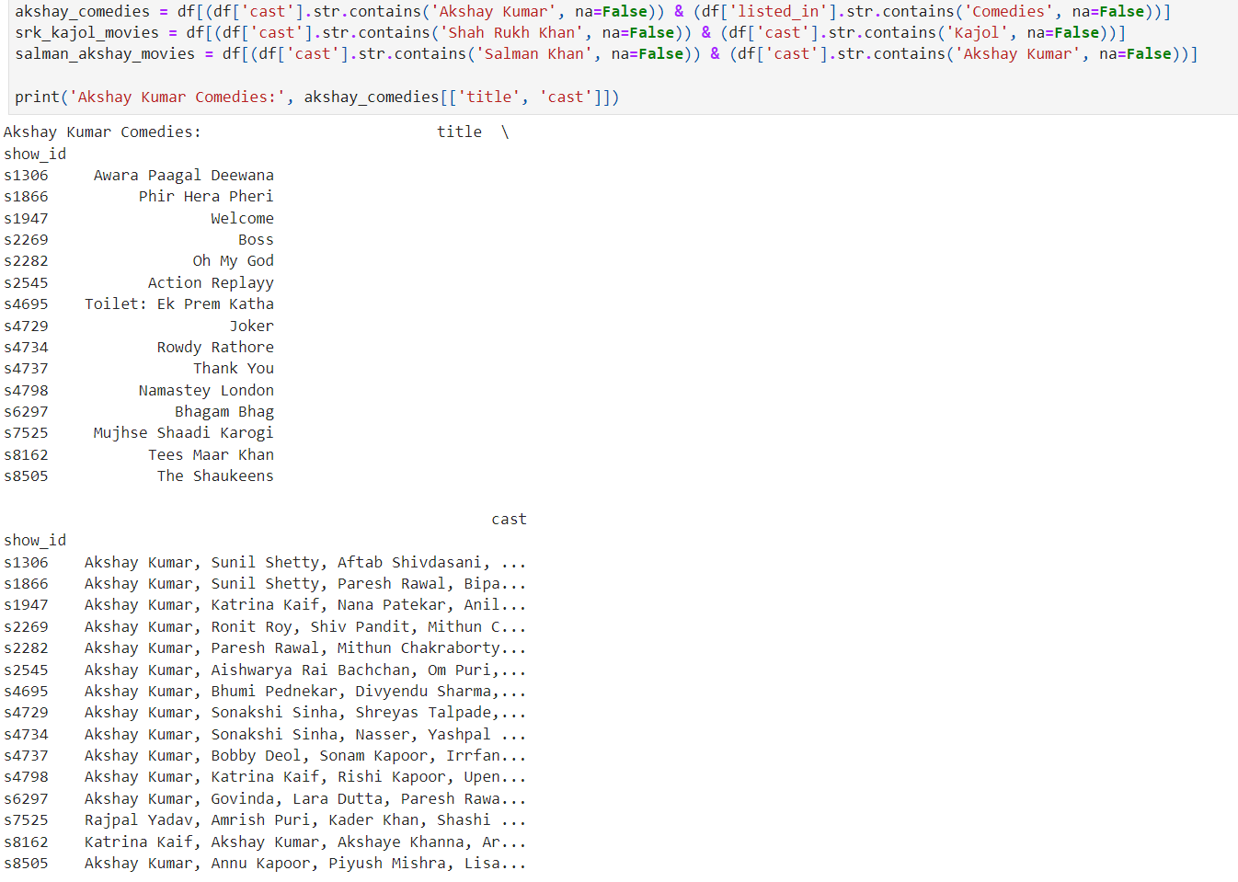
Actor Collaborations: Akshay Kumar Comedies

Slide 30
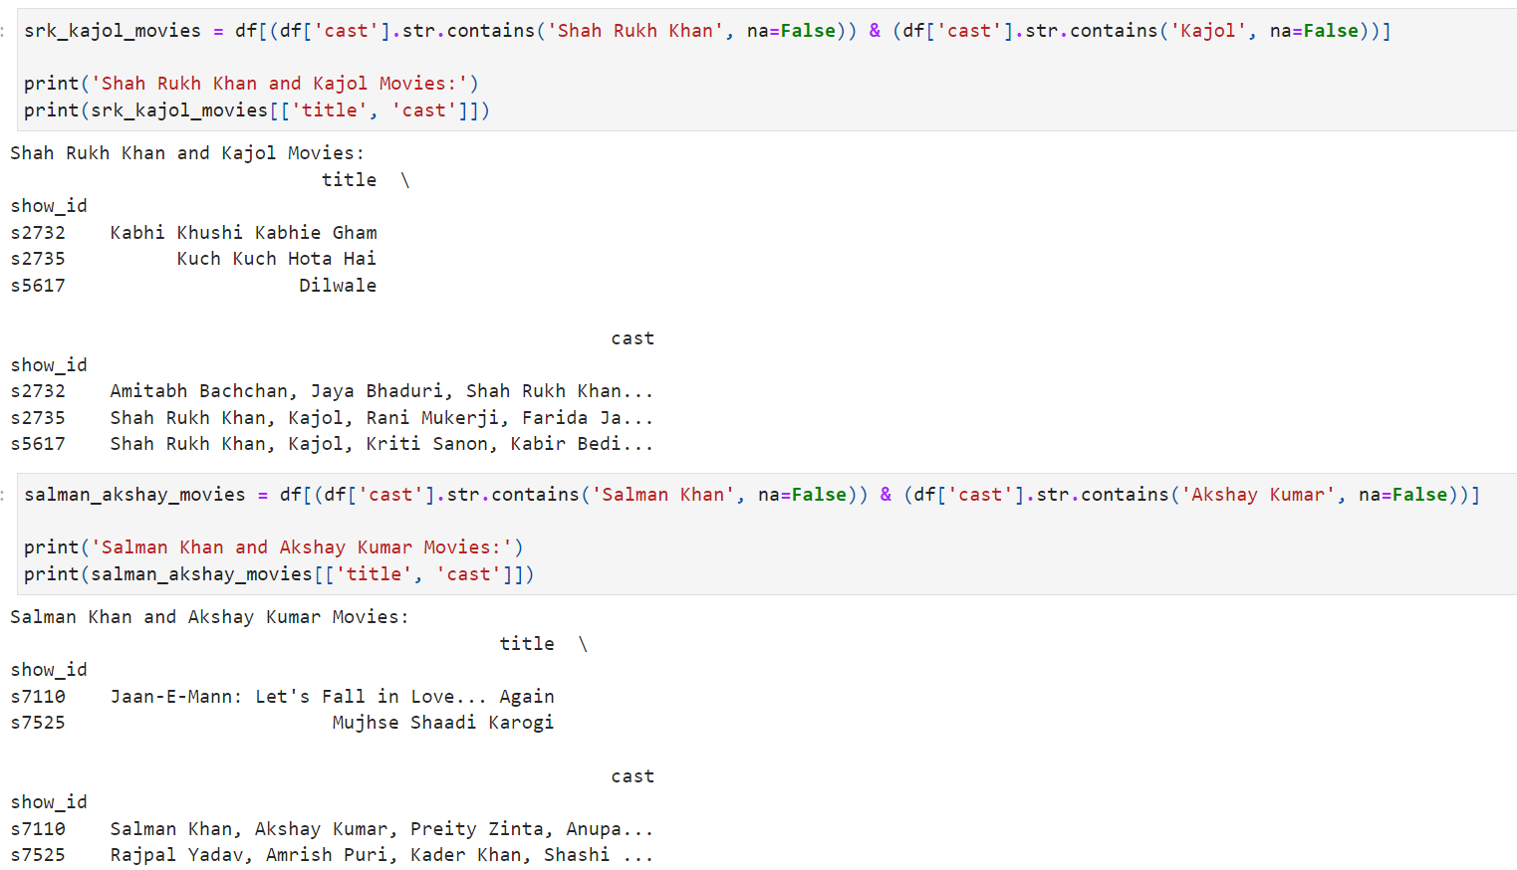
Actor Collaborations: SRK-Kajol Movies and Salman-Akshay Movies

Slide 31
Insights
Akshay Kumar:
Known for versatile comedy roles.
Frequent collaborations with actors like Paresh Rawal and Katrina Kaif.
Shah Rukh Khan & Kajol:
Iconic Bollywood pair.
Movies include timeless classics (Kuch Kuch Hota Hai, Kabhi Khushi Kabhie Gham).
Salman Khan & Akshay Kumar:
Limited but memorable collaborations (Jaan-E-Mann).

Slide 32
Which Director has made the most TV Shows

Slide 33
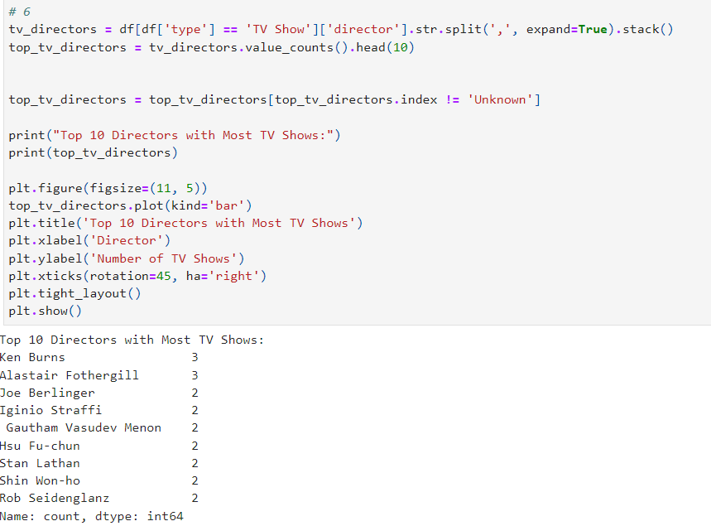
Leading Directors(Code)

Slide 34
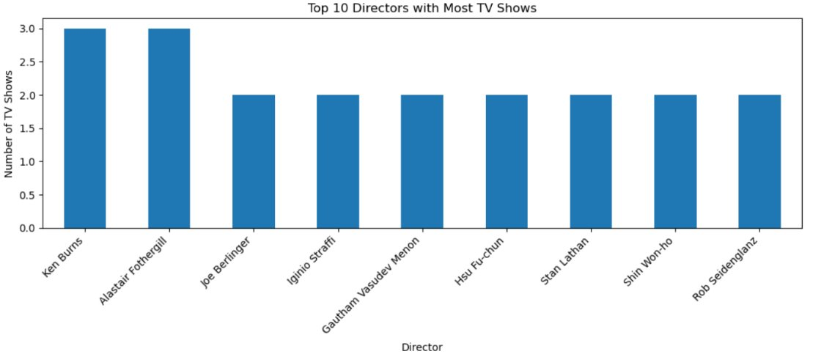
Graph

Slide 35

Insights
Ken Burns and Alastair Fothergill: Directed the most TV shows (3 each).
Diversity in directors suggests Netflix’s broad sourcing of creative talent.

Slide 36
Actors and Actress who have given the most Number of Movies

Slide 37
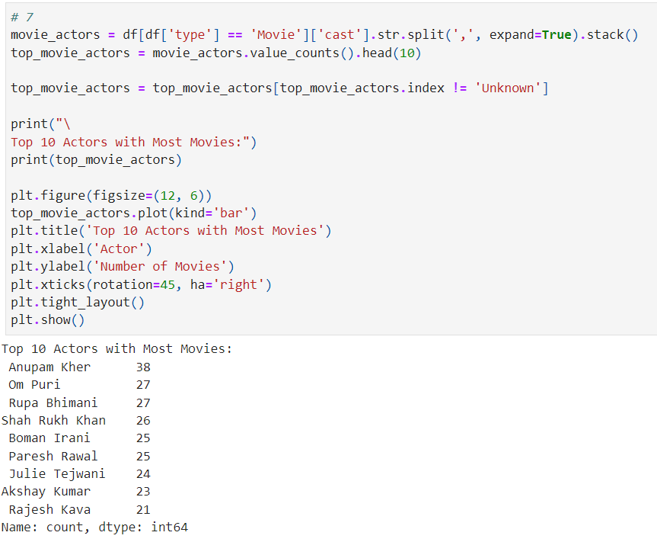
Actors with Most Appearances(Code)

Slide 38
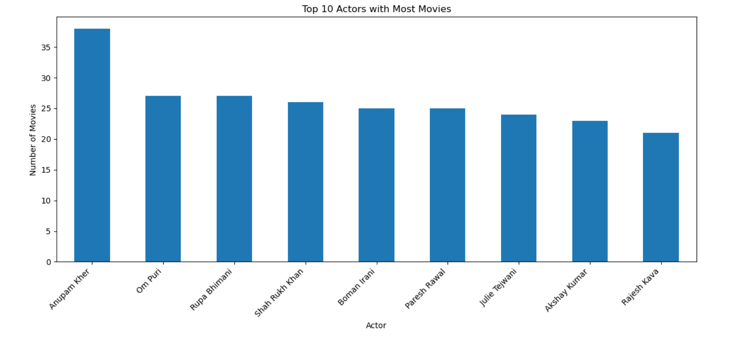
Graph

Slide 39
Insights
Top Actor: Anupam Kher leads with maximum movie appearances.
Top Actress: Rupa Bhimani with 27 movies
Shah Rukh Khan and Akshay Kumar rank high for their diverse contributions.

Slide 40
Find out which types of genre has most movies and TV Shows

Slide 41
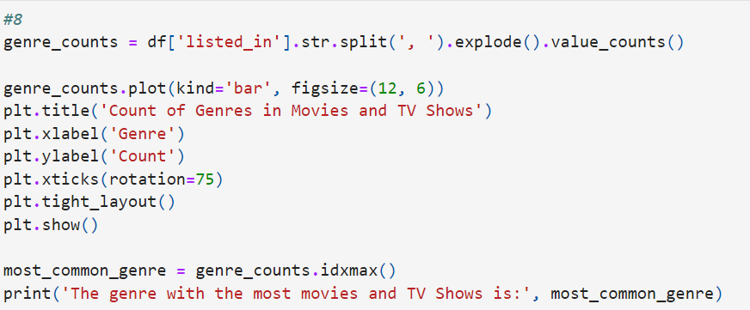
Most Popular Genres(Code)

Slide 42
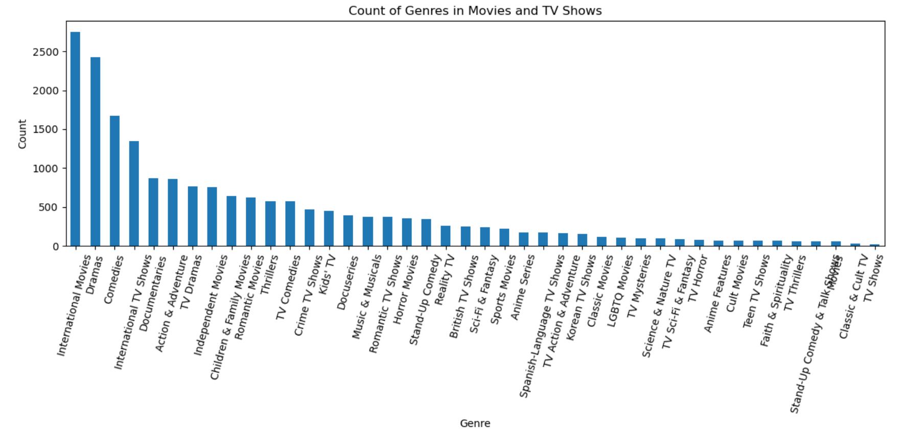
Graph

Slide 43
Insights
Top Genres:
International Movies
Dramas
Comedies
Observation:
Netflix offers a broad array of genres, with a strong preference for international content, drama, and comedy. This variety suggests Netflix caters to a wide audience with diverse tastes.

Slide 44

Conclusion
Summary: Through this analysis, we’ve explored Netflix’s content strategy and audience preferences. The findings reveal:
Strong reliance on popular genres like International Movies, Dramas, and Comedies.
Frequent collaborations between top Bollywood actors.
A significant shift in content trends post-2020.
Impact: This analysis can help inform future content decisions, giving Netflix insight into audience trends, preferred genres, and key actors to focus on.

Slide 45

Thank You
A Presentation By Vijay Rangaswamy

